Slide 1


Sentiment Analysis : Predicting sentiment of COVID-19 tweets

Slide 2
PROBLEM STATEMENT
PROBLEM DESCRIPTION,
This challenge is to build a classification model to predict the sentiment of COVID-19 tweets.
The tweets have been pulled from Twitter and manual tagging has been done.

Slide 3
DATA DESCRIPTION
Coronovirus_Tweets is the dataset of tweets that have been pulled from Twitter and manual tagging on sentiment is done.
This dataset includes the variables:
Location
Tweet At
Original Tweet
Label

Slide 4
DATA DESCRIPTION
Variables description:
Location – It shows the user location from where he tweets
Tweet At – It shows the time of tweet
Original Tweet – It shows the content of the tweet
Sentiment – it shows the sentiment of the user, whether positive,negative or neutral

Slide 5
CONTENTS
Visualization Analysis
Preprocessing the Data
ML-Classification Models
ML-Evaluation Metrics
conclusion

Slide 6
STEPS INVOLVED
Importing the Dataset
Dataset Inspection
Exploratory Data Analysis
FEATURE ENGINEERING
ML Classification Model
ML classification Model Evaluation
Text-preprocessing

Slide 7
DATA SUMMARY
Name of the Dataset | Coronovirus Tweets
Number of variables | 6
Number of observations | 41157
Duplicate rows | 0
Total size in memory | 256 kb
Missing Data (Columns) | Location | 8590

Slide 8
VARIABLE DATA TYPE
Date Type | Column
Numeric - int64 | 0 UserName 1 ScreenName
String - object | 2 Location 3 TweetAt 4 OriginalTweet 5 Sentiment

Slide 9
DATASET INSPECTION
The shape of the dataset is (41157, 6)
The Null Values in the column-Location is 8590. The rows which contains null values are removed. The final dataset size is (32567,6)
The number of duplicate rows in the dataset are 0

Slide 10
TEXT PREPROCESSING
Text preprocessing is the very first step of NLP projects.
Some of the preprocessing steps are:
Removing punctuations like . , ! $( ) * % @
Removing URLs
Removing Stop words
Lower casing
Tokenization
Lemmatization

Slide 11
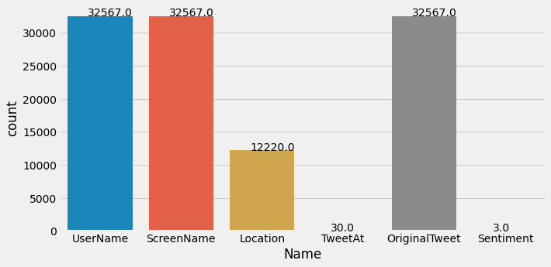
EXPLORATORY DATA ANALYSIS (EDA)
TO DETERMINE THE UNIQUE VALUES IN EACH COLUMN
From the graph,
Location column shows 12220 are unique, so we will remove the columns which has null values.
TweetAt column shows only 30 unique values, so our dataset may contain data for a month.
Sentiment columns has 3 unique values i.e., positive, Negative, neutral

Slide 12
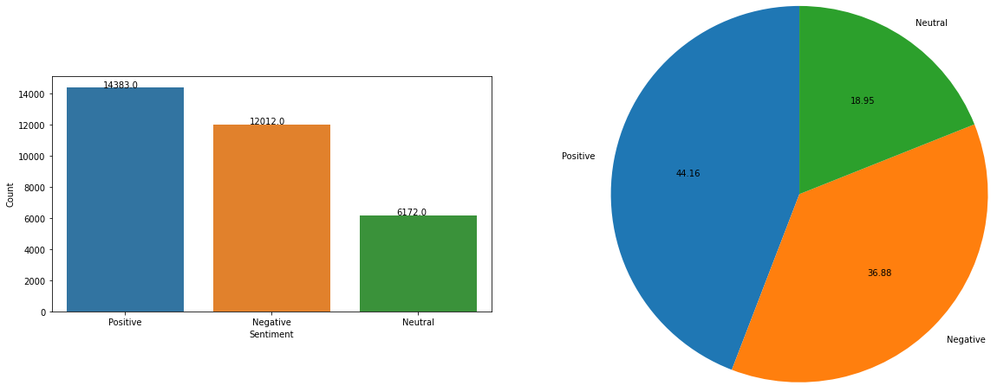
EXPLORATORY DATA ANALYSIS (EDA)
from the figure,
we can infer that there are more positive tweets rather than negative and neutral .
The class is imbalanced

Slide 13
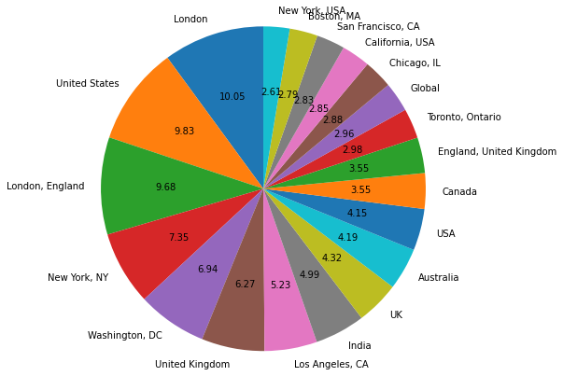
EXPLORATORY DATA ANALYSIS (EDA)
TO VISUALIZE THE TOP 20 LOCATION OF TWEETS
Most covid-related tweets seem to come from four major countries - United States , India , Canada , United Kingdom.
London, New York lead the way in terms of cities that tweeted the most about covid19

Slide 14
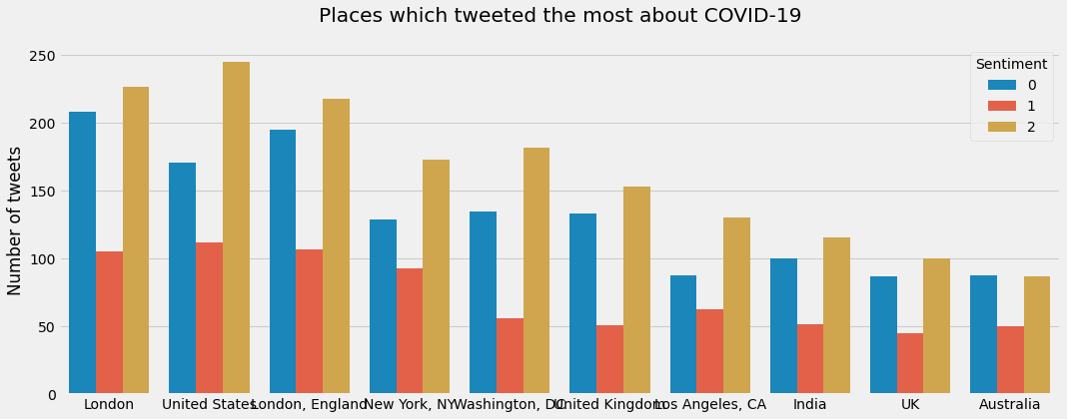
EXPLORATORY DATA ANALYSIS (EDA)
TO ANALYZE THE SENTIMENTS OF TOP 10 LOCATIONS
We also observe a pattern: there are more positive tweets than negative in all cities/countries.

Slide 15
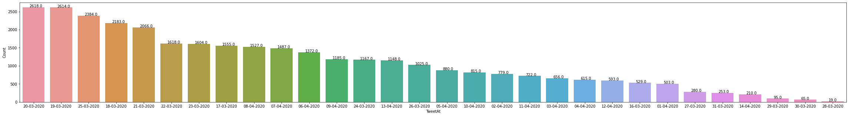
EXPLORATORY DATA ANALYSIS (EDA)
TO VISUALIZE THE DATE ON WHICH MAXIMUM TWEETS OCCURED
From the figure, maximum number of tweets occurred from 17th march 2020 to 24th march 2020

Slide 16
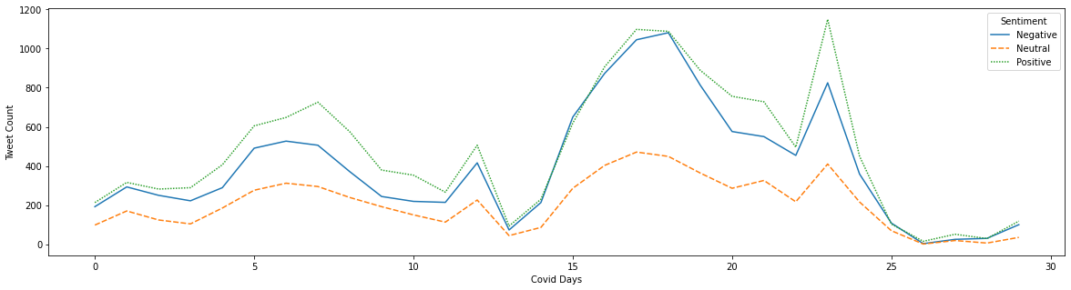
EXPLORATORY DATA ANALYSIS (EDA)
TO ANALYZE THE SENTIMENT OVER THE COVID DAYS
from the graph,
* positive tweets counts are higher in all the covid days.
* In the 30 covid days of tweets, first 10 days has more number of tweets

Slide 17
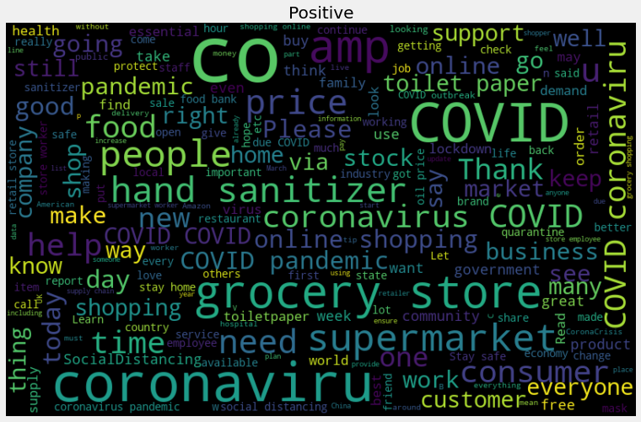
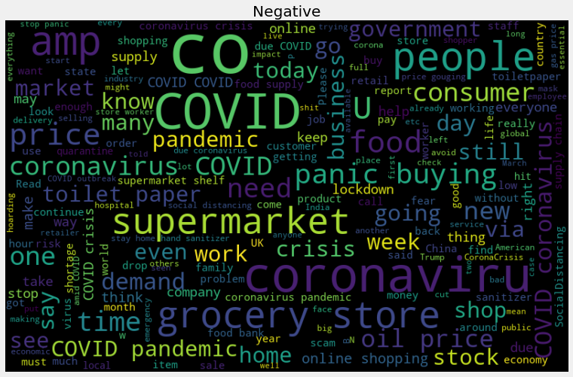
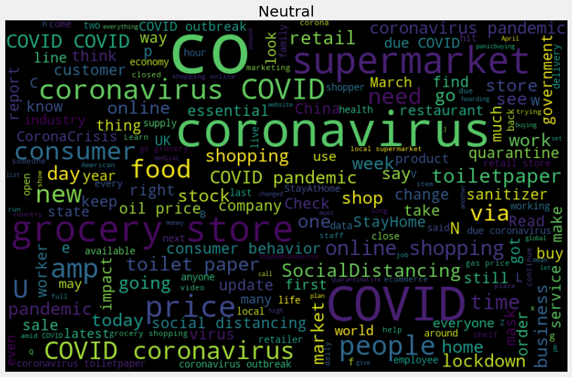
EXPLORATORY DATA ANALYSIS (EDA)
WORD CLOUD

Slide 18
FEATURE ENGINEERING
Bag of words is a Natural Language Processing technique of text modelling. It's an algorithm that transforms the text into fixed-length vectors.
CountVectorizer - Convert a collection of text documents to a matrix of token counts. This implementation produces a sparse representation of the count.
The shape of the dataset after the pre-processing process is (32567, 5636)

Slide 19
ML- CLASSIFICATION MODEL
For Train –Test data split up , I have considered 0.25 as threshold, So that train data will be around 24000 rows to train the model.
To classify the covid tweets, following classification models are created
Decision Trees
Random Forest
XGBoost
K-Nearest Neighbours
Naive Bayes

Slide 20
ML - REGRESSION MODEL
 | Classification_Model | Train_auc_roc_score | Test_auc_roc_score | Train_precision | Test_precision | Train_Recall | Test_Recall | Train_f1-score | Test_f1-score | Train_accuracy | Test_accuracy
 | Decision Trees | 0.574281 | 0.569572 | 0.484831 | 0.478752 | 0.484831 | 0.478752 | 0.484831 | 0.478752 | 0.484831 | 0.478752
1 | Random Forest | 0.821023 | 0.816060 | 0.512917 | 0.513265 | 0.512917 | 0.513265 | 0.512917 | 0.513265 | 0.512917 | 0.513265
2 | XGBoost | 0.943317 | 0.893640 | 0.833449 | 0.775608 | 0.833449 | 0.775608 | 0.833449 | 0.775608 | 0.833449 | 0.775608
3 | K-Nearest Neighbours | 0.921483 | 0.628398 | 0.549437 | 0.353967 | 0.549437 | 0.353967 | 0.549437 | 0.353967 | 0.549437 | 0.353967
4 | Naive Bayes | 0.893728 | 0.843170 | 0.750338 | 0.690739 | 0.750338 | 0.690739 | 0.750338 | 0.690739 | 0.750338 | 0.690739

Slide 21
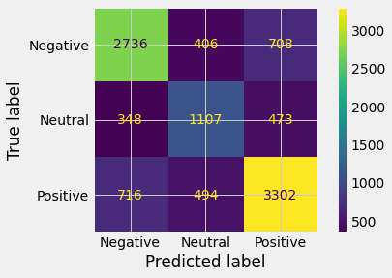
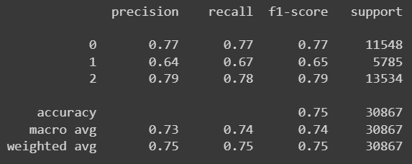
ML - REGRESSION MODEL
NAÏVE BAYES
CONFUSION MATRIX
CLASSIFICATION REPORT

Slide 22
CONCLUSION
Conclusion
From the classification- evaluation metrics
Only XGBoost gives, very high score in all the parameters, followed by Naive Bayes
Decision tree, random forest, KNN are struggling hard for the sentiment analysis.
XGBoost consumes more time to train the model, but Naive Bayes consumes very less time, based on the performance and score , naive bayes algorithm is best suitable for sentiment analysis.

